Slide 1

PHP Fundamentals
{mobidev}

Slide 2
What we’ll cover:
PHP basic Syntax
Variables and Arrays
Math functions & Flow Control (Control Structures)
Switch Case
Loops
Functions & Includes
{mobidev}

Slide 3
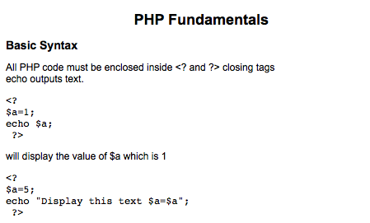
PHP Basic Syntax:
{mobidev}

Slide 4
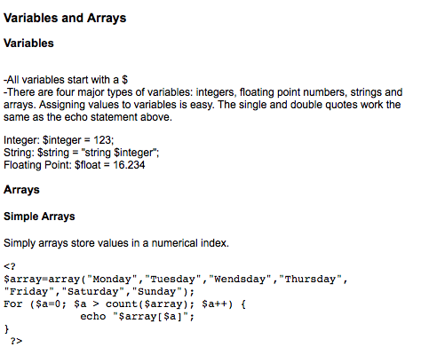
Variables & Arrays:
{mobidev}

Slide 5
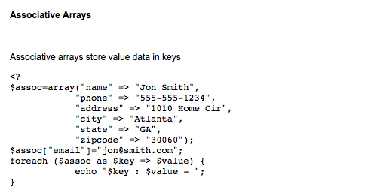
Variables & Arrays:
{mobidev}

Slide 6
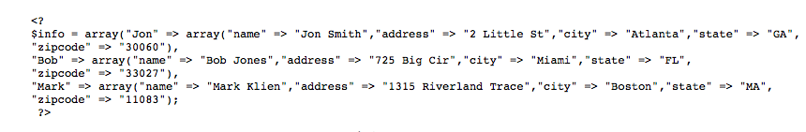
Multidimensional Arrays:
{mobidev}

Slide 7
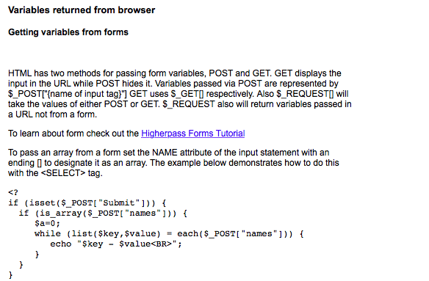
Variables from the browser/forms:
{mobidev}

Slide 8
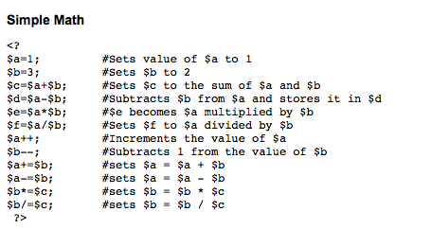
Simple Math
{mobidev}

Slide 9
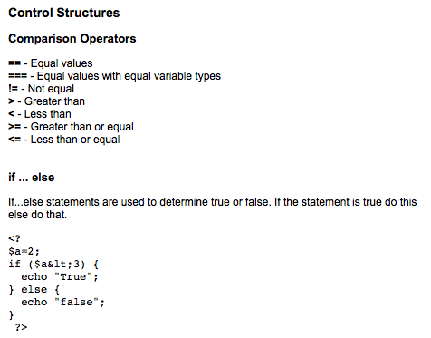
Control Structures
{mobidev}

Slide 10
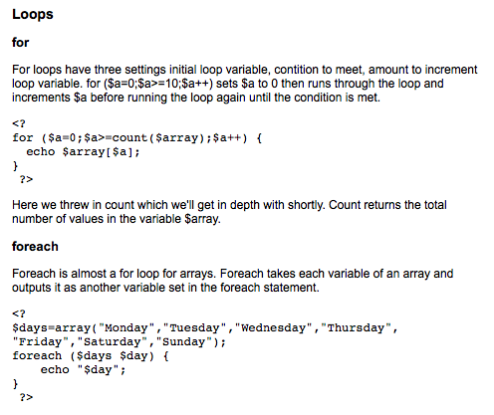
Loops
{mobidev}

Slide 11
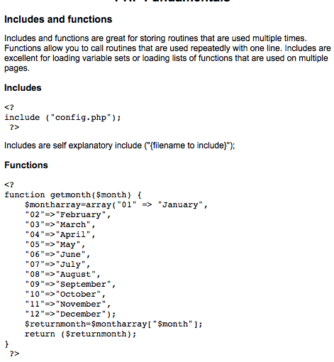
Includes
{mobidev}

Slide 12
Functions
{mobidev}

Slide 13
A few inbuilt functions
Explode
Empty
Is_numeric
Is_array
{mobidev}

Slide 14
Thank you :
Questions are welcomed
{mobidev}

